Slide 1

Auto-Valuator: Resale King
Used Car Price Prediction Using Machine Learning
Model Builders TeamBCA - Machine Learning Project
Team Members: Deepa, Meghana, Shruti, Ashwini, Gouri, Nayana

Slide 2

Why Used Car Pricing Matters
Buying or selling a used car? Pricing is tricky without expertise. The resale value depends on many factors—from mileage to ownership history. Traditional methods rely on market research and guesswork, leading to inconsistent valuations.
Machine Learning offers a data-driven solution that analyzes patterns and predicts accurate prices based on real market data.

Slide 3

Understanding the Problem
Buyers Overpay
Sellers Underprice
No Standard System
Without accurate data, buyers often pay more than a vehicle's actual market value
Sellers may list their cars too low, losing potential revenue on their investment
Lack of automated tools makes price comparison time-consuming and unreliable
Our goal: Build an automatic price prediction system that provides fair, accurate valuations for everyone.

Slide 4

Dataset Overview
Data Source
Collected from CarDekho dataset on Kaggle, containing real-world used car listings with comprehensive vehicle details.
Key Features
Year of manufacture
Kilometers driven
Fuel type (Petrol, Diesel, CNG)
Transmission (Manual, Automatic)
Owner number (1st, 2nd, 3rd+)
Selling price (target variable)

Slide 5





Our Methodology
Data Collection
Gathered comprehensive used car listings from CarDekho dataset
Data Preprocessing
Cleaned data, handled missing values, encoded categorical variables
Model Training
Trained multiple ML algorithms with cross-validation
Model Testing
Evaluated performance using accuracy metrics
Price Prediction
Deployed best model for real-time valuations

Slide 6
Machine Learning Models Used
Ridge Regression
Lasso Regression
Decision Tree
How it works: Controls overfitting by adding a penalty to large coefficients
How it works: Removes less important features by shrinking their coefficients to zero
How it works: Predicts price through a series of logical decision steps based on input features
Why we chose it: Handles multicollinearity well and provides stable predictions even with correlated features
Why we chose it: Performs automatic feature selection, simplifying the model while maintaining accuracy
Why we chose it: Easy to interpret, handles non-linear relationships, and works well with mixed data types

Slide 7

Results & Implementation
Model Performance
After testing all three models, Decision Tree showed the best accuracy for our dataset. It effectively captured the complex relationships between car features and selling prices.
Backend Technology Stack
Python: Core programming language
Flask: Web framework for API development
Scikit-learn: ML library for model training
Pandas & NumPy: Data manipulation
Deployment
Successfully built a web application that users can access to get instant price predictions by entering their car details.

Slide 8
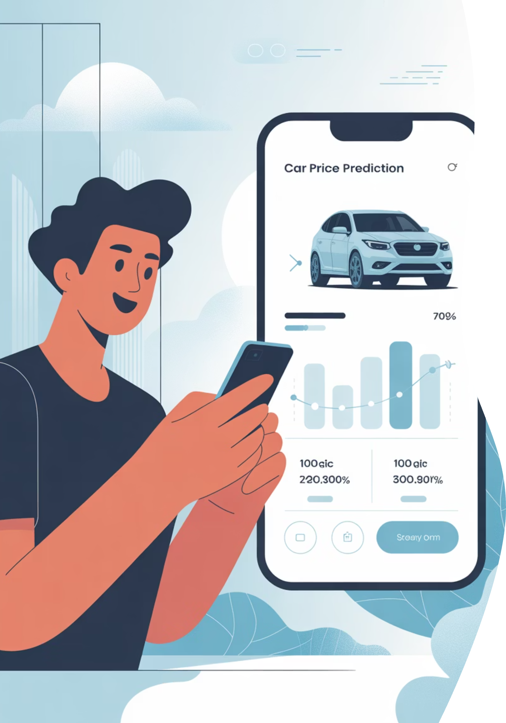
Conclusion
Accurate Predictions Achieved
Successfully built a machine learning system that predicts used car prices with high accuracy
Practical Value
Helps both buyers and sellers make informed decisions in the used car market
Scalable Solution
Web-based application can serve multiple users simultaneously with real-time predictions

Slide 9
Future Enhancements
Real-Time Data Integration
Advanced ML Models
Connect to live market databases for current pricing trends and updates
Implement ensemble methods like Random Forest and Gradient Boosting for improved accuracy
Regional Pricing
Mobile Application
Include location-based factors to account for regional market variations
Develop iOS and Android apps for on-the-go price predictions

Slide 10
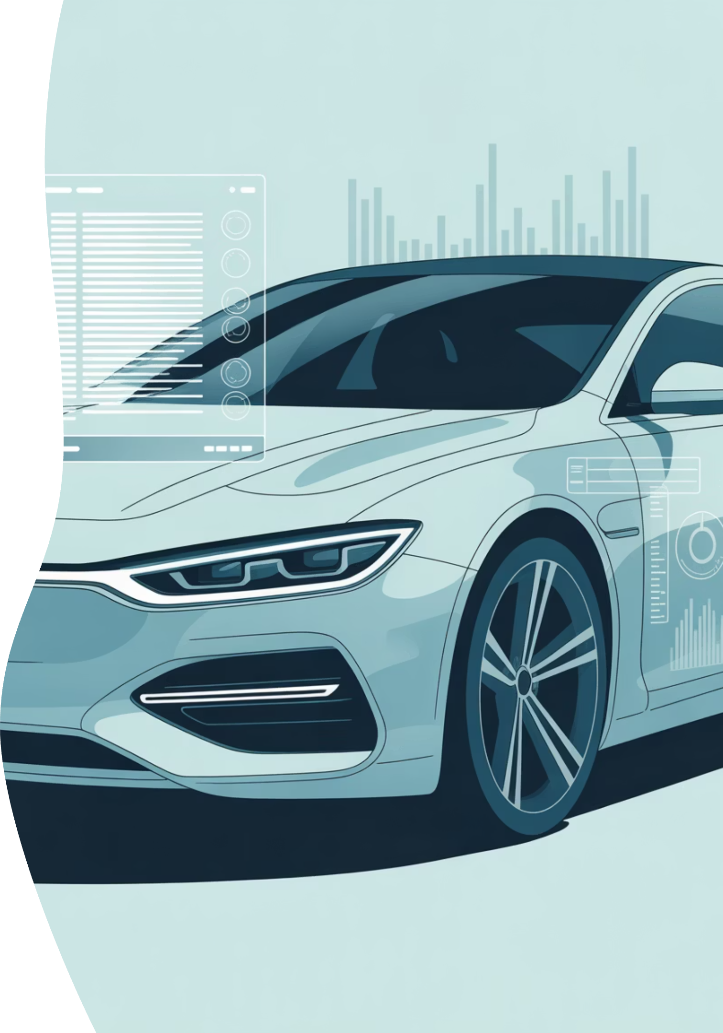
Thank You
Questions?
Get Involved
We're ready to discuss our methodology, results, or implementation details
Interested in contributing to this project? Contact our team for collaboration opportunities
Project Repository
Source code and documentation available for academic review and further development
Model Builders TeamBCA - Machine Learning
Auto-Valuator: Resale King

